Slide 1
Cyber Physical System
Internal Assessment (IA-2)
Cyber-Physical System Framework for
Future Aircraft and Air Traffic Control
Authors: Krishna Sampigethaya, Radha Poovendran
Presenter: Asim Ahmed Siddiqui (2021014)

Slide 2
TABLE OF CONTENTS
1. INTRODUCTION
2. CYBER-PHYSICAL SYSTEM (CPS)
3. FUTURE E-ENABLED AIRCRAFT AS A CPS
4. MODERN ATM AS A CPS
5. GROUP FLIGHT: CPS SOLUTION FOR ATM
6. MAJOR CHALLENGES AND OPEN PROBLEMS
7. CONCLUSIONS
REFERENCES

Slide 3
Abstract
This paper proposes a novel cyber-physical system (CPS) framework for aircraft and airspace system design and performance assurance.
The paper present the foundational role of the e-enabled aircraft in the worldwide air transport system modernization.
We show how automated air navigation and surveillance depend on tight integration and controlled coordination between in-aircraft systems and off-board systems in ground, air, and space.
Based on the concept of “group flight,” we propose a fundamental CPS solution for controlling large volumes of manned and unmanned air traffic using Automatic Dependent Surveillance Broadcast (ADS-B) and Internet Protocol (IP) technology.

Slide 4
INTRODUCTION
Aviation today is facing a challenge of accommodating a multi-fold increase in air traffic and additional types of manned and unmanned aircraft classes in the next two decades;
Airspace systems worldwide are now modernizing with the intent of substantially improving the capacity, safety, security, efficiency, and yield of aviation and outpace future demands.
The “e-enabled aircraft” – an aircraft envisioned capable of seamlessly traversing a global information network of ground, air, space infrastructures as an intelligent node – is vital towards meeting aviation’s grand challenge.

Slide 5
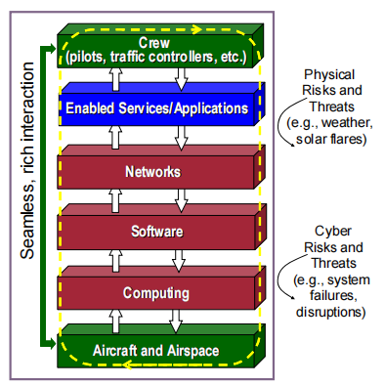
INTRODUCTION
“Cyber” is synonymous with a mixed composition of computation, storage, software, and networking.
Airspace systems and the e-enabled aircraft embed the highly intangible cyber elements in hardware, infrastructures and humans for various purposes.
Notes:
Controlling electrical, mechanical, thermal, hydraulic components and processes onboard (e.g., flight controls), to in-flight entertainment (e.g., networking of seat monitors), to coordination between aircraft and ground stations (e.g., radar surveillance) as well as between pilots and air traffic controllers (e.g., controller-pilot data link communications) – all depending on a loose coupling between cyberspace and physical domain.

Slide 6
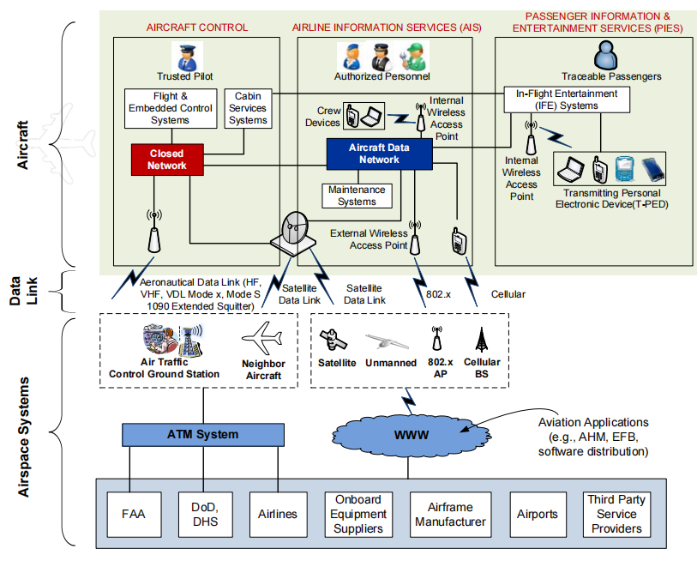
Future e-enabled aircraft and its integration with airspace system

Slide 7
NEED OF THE RESEARCH
This paper proposes a preliminary Cyber-Physical System (CPS) framework for understanding the complex interactions of future aircraft and airspace systems.
We consider the e-enabled aircraft as a small-scale CPS and Air Traffic Management (ATM) system as a large-scale CPS.
A major contribution of our proposed framework, hence, is a foundational perspective of how cyber, with its unique features and technologies, fits into the alien environment of aviation;

Slide 8
2. CYBER-PHYSICAL SYSTEM (CPS)
Emerging today as a research area worldwide, CPS focuses on the complex interdependencies and integration between cyberspace and physical world and develops a fundamental understanding of system behavior and performance requirements.
CPS is an emerging vision for next-generation systems that boldly transform the way modern society perceives the physical world, lives, moves, and interacts in it, and systems on which human safety and public well being rests
Based on its paramount importance to society and industrial growth, CPS was reported a top-priority research area by the United States President’s Council of Advisors on Science and Technology in 2007

Slide 9
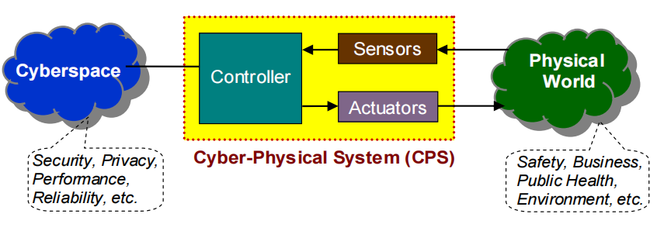
2. CYBER-PHYSICAL SYSTEM (CPS)

Slide 10
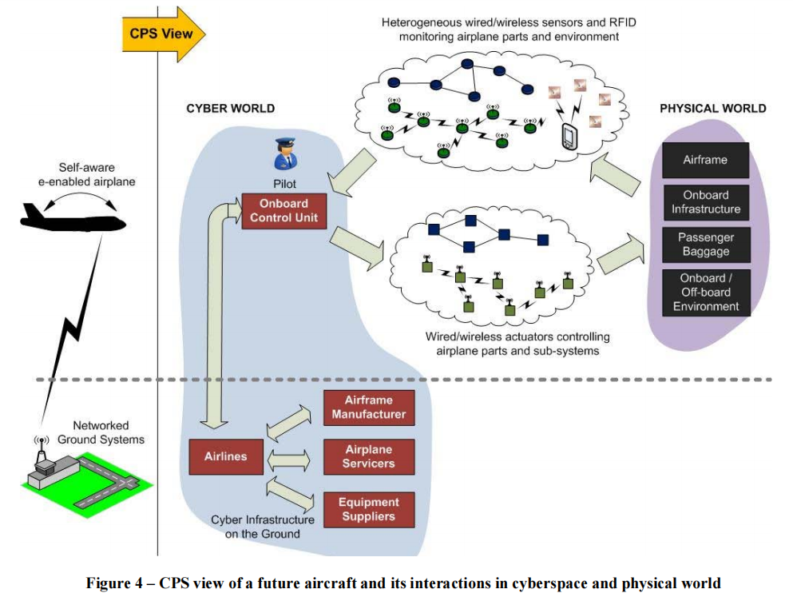
3. FUTURE E-ENABLED AIRCRAFT AS A CPS

Slide 11
3. FUTURE E-ENABLED AIRCRAFT AS A CPS
CPS for airplane health management can be envisioned to consist of an onboard wired and wireless sensory network that sources timely accurate feedback to onboard computers and flight deck crew,
about the status of the aircraft’s physical environment (internal and external),
hardware and software parts,
physical and cyber infrastructure,
and occupant humans.
Real-time monitoring of airplane status
– including all human and other physical components contained with the airframe
– predictive and proactive maintenance for airplane health management,
– pilot fatigue management, hence, can be achieved.

Slide 12
3. FUTURE E-ENABLED AIRCRAFT AS A CPS
Future aircraft navigation and surveillance depends on technologies, such as,
Automatic Dependent Surveillance Broadcast (ADS-B),
Global Navigation Satellite System (GNSS),
Internet Protocol Aeronautical Telecommunication Network (IP ATN),
to make the aircraft and flight deck crew see the same realtime “picture” of traffic and weather as seen by the air traffic controllers.
This capability allow the aircraft to navigate in the presence of unpredictable weather conditions, unforeseen events, and dynamic aircraft operator priorities, ultimately helping to perform gate-to-gate flight in a highly precise and predictable time.
However, to achieve such futuristic navigation and surveillance the aircraft requires tight cyber-physical integration and controlled interactions with off-board systems on the ground and in air and space.

Slide 13
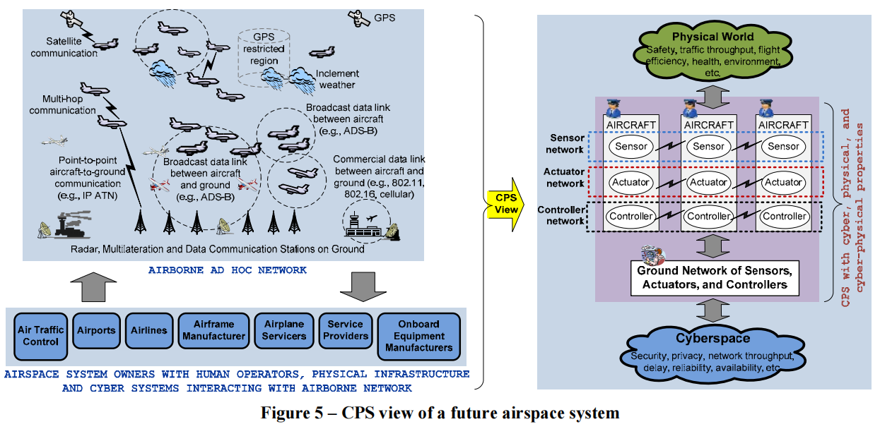
4. MODERN ATM AS A CPS

Slide 14
4. MODERN ATM AS A CPS
Future ATM systems, in the next two decades and beyond, aim to control a multi-fold volume of manned and unmanned air traffic in an airspace that will continue to face capacity constraints, dynamics and performance risks from deteriorating weather, atmospheric and solar conditions (e.g., global warming, solar flares), wildlife populations, and last but not least, human-actuated threats (e.g., controller fatigue and terrorists).
System performance goals include
safety, capacity, security (i.e., cyber, physical, and cyber-physical),
efficiency (e.g., time, costs, fuel based metrics),
sustainability (i.e., noise and carbon footprint of aviation), and
agility (i.e., response to unexpected dynamics and emergencies in airspace)

Slide 15
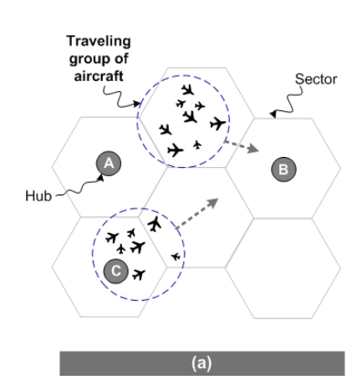
5. GROUP FLIGHT: CPS SOLUTION FOR ATM

Slide 16
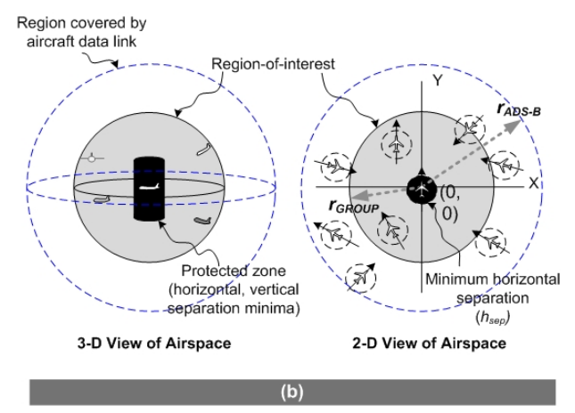
5. GROUP FLIGHT: CPS SOLUTION FOR ATM

Slide 17
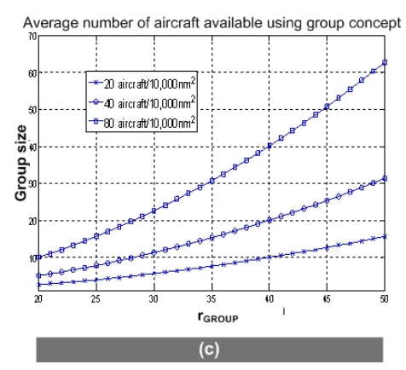
5. GROUP FLIGHT: CPS SOLUTION FOR ATM

Slide 18
6. MAJOR CHALLENGES AND OPEN PROBLEMS
Wireless Control Systems for Aviation:
The air traffic control network will be used by manned and unmanned air vehicles in the shared airspace and additionally be used for distribution of large volumes of potentially non-safety critical data, e.g., traffic information and updates from ground systems.
The control networks must however exhibit determinism for timecritical operations, e.g., in terms of end-to-end delay and packet delivery rate.
Hence the performance of mechanisms for secure wireless networked control of non-safety and safety-critical operations under mixed network traffic loads and air traffic density must be studied, both for future aircraft and ATM systems.

Slide 19
6. MAJOR CHALLENGES AND OPEN PROBLEMS
Security Solution Considerations:
Cyber elements, i.e., computers and networks, have vulnerabilities to malicious disruption and misuse.
Cyber threats must be assessed for their potential impact on expected physical behavior and performance gains of future aircraft and airspace systems.
Furthermore, physical threats due to bad weather, icing, winds, solar flares, can be detrimental to cyber performance (e.g., GPS outage).
Most aviation standards do not yet cover cyber-physical threats. Community efforts have begun to bridge some of these gaps.

Slide 20
7. CONCLUSIONS
The paper presented the emerging Cyber-Physical System (CPS) area to the aerospace community that modeled future e-enabled aircraft and air traffic management (ATM) systems as CPS instances to show how tight integration between cyberspace and physical world can enrich interactions in aircraft and airspace.
The resulting framework helps understand the effective use of cyber technology for aviation, and streamlines the informed use of cyber for enhance aviation performance.
The paper proposed an innovative solution called group flight that uses ADS-B and IP network links of two or more geo-proximate aircraft and combines them as a single traceable airborne node for ATM systems.

Slide 21
7. CONCLUSIONS
This paper is the first to present an aviation CPS vision for e-enabled aircraft and modern networked ATM.
Future work includes developing the proposed preliminary aviation CPS framework and the proposed group flight concept.

Slide 22
REFERENCES
[1] J. Wiley, “FAA test challenges in the 21st century,” ITEA Journal, 29: 117–119, 2008.
[2] S. Shetty, “System of systems design for worldwide commercial aircraft networks,” Proceedings of ICAS, ICAS 2008-8.4.1, 2008.
[3] “E-Enabling,” Boeing Frontiers, 02:04, August 2003.
http://www.boeing.com/news/frontiers/archive/2003/august/i_ca1.html
[4] C. Wargo and C. Dhas, “Security considerations for the e-enabled aircraft,” 2003 IEEE Aerospace Conference Proceedings, 2003.
[5] K. Sampigethaya, R. Poovendran, L. Bushnell, “Secure operation, maintenance and control of future e-enabled airplanes,” Proceedings of the IEEE, 96:12, pp. 1992-
2007, Dec. 2008.

